Slide 1

Customer Churn Analysis
Understanding and Predicting E-Commerce Customer Churn
Presented by: Kenechukwu Enem
Date: 1st February 2025

Slide 2
Introduction
Dataset Overview
Data Preparation and Model Prediction
Analysis of Churn by Different Features of the data
Predictive Model Comparison
Business Insights and Recommendation
Conclusion and Greetings

Slide 3
Dataset Overview
- Source: E-commerce customer transactions dataset from Blackboard.
- Key Features: Customer demographics, usage behavior, payment preferences, complaints, satisfaction scores, etc.
- Target Variable: Churn
(1 = Churned, 0 = Retained)
Objective: To identify/predict the groups of people most likely to churn next.

Slide 4

Data Preparation & Model Prediction
- Removed missing values and duplicates.
- Converted categorical variables into numerical values.
- Normalized numerical data for better model performance.
Formatted display of numerical values for clarity
Created categories for Tenure grouping
Plotted graphs for understanding the data distribution
Performed Scaling and Feature Engineering
Training, testing and predicting with different models

Slide 5
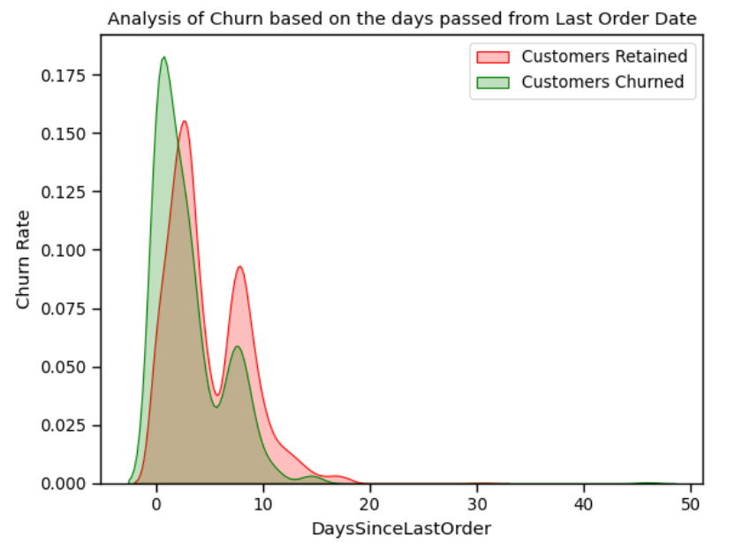
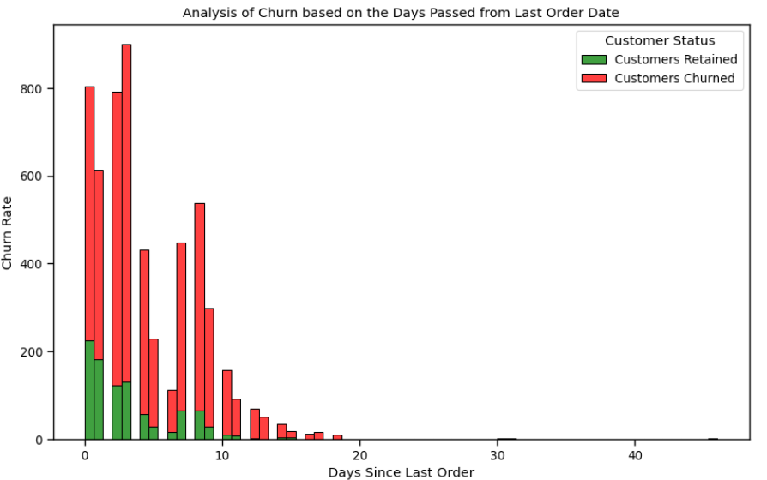
Churn by Recency (Days Since Last Order)
Chart: KDE Plot
Observation: Customers with fewer days since their last order tend to have a higher churn rate. This may appear unusual because one might expect customers with shorter tenure to be retained. The likely explanation is that the business attracts more walk-in clients, particularly for products like mobile phones, where the purchase cycle can span several years.
Suggestions: Further analysis should consider customer behavior patterns and product lifecycle. Investigating specific customer segments (e.g., one-time buyers vs. repeat buyers) could provide deeper insights for drawing conclusions.

Slide 6
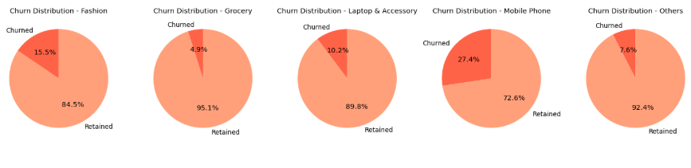
Churn by Preferred Order Category
Chart: Pie Chart
Observation: Certain product categories, particularly mobile phones, are associated with higher churn rates. Mobile phones have the highest churn, followed by laptops and accessories. This suggests that customers may not frequently return for these categories, possibly due to the longevity of the product lifecycle or market saturation.
Suggestions: Investigate possible reasons for this trend, such as customer satisfaction, product obsolescence, or competition. Offering incentives for repeat purchases or loyalty programs could reduce churn in these categories.

Slide 7
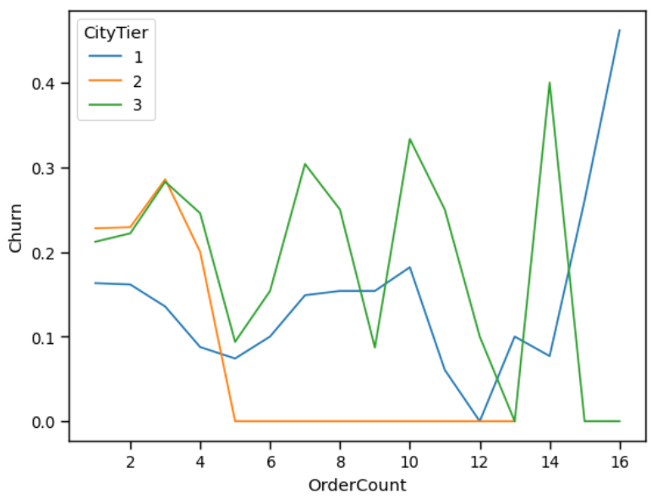
Churn by Order Count and City Tier
Chart: Line Plot
Observation: There is a high churn rate among customers with higher order counts, particularly in tier 1 and tier 3 cities. The churn in tier 2 cities is comparatively lower. This could be due to operational challenges or issues related to stock availability at warehouses, affecting customers’ order fulfillment experience.
Suggestions: Investigate logistical and operational issues affecting tier 1 and tier 3 cities. Improving stock management and streamlining operations in these regions could help reduce churn. Additionally, offering localized customer support or incentives could improve retention.

Slide 8
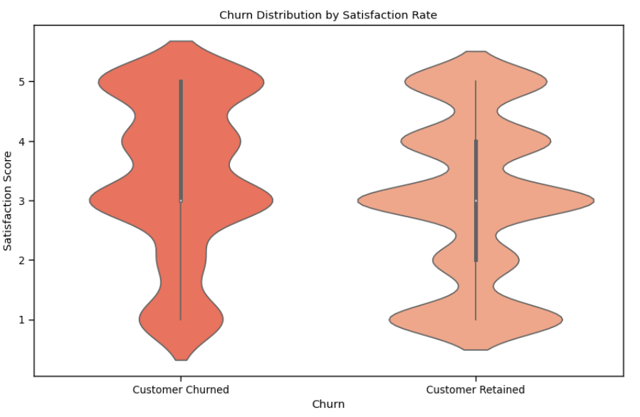
Churn by Satisfaction Score
Chart: Violin Plot
Observation: Customers who provide lower satisfaction scores tend to churn at higher rates. However, it is notable that some customers who rated their experience highly still chose to leave. This indicates that satisfaction scores alone may not fully capture the reasons behind customer retention or churn.
Suggestions: Explore other factors influencing customer retention, such as post-purchase experience, customer support interactions, or external factors like product availability. Conducting deeper customer feedback analysis could help identify pain points not captured by satisfaction scores.

Slide 9
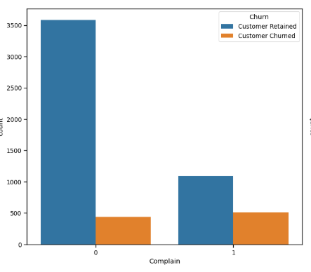
Churn by Complaints
Chart: Bar Graph
Observation: Customers with more complaints are more likely to churn. Approximately 50% of customers who reported complaints about the service eventually churned. Even though some of these customers provided high satisfaction scores, the complaints seem to have a stronger influence on their decision to leave.
Suggestions: Addressing customer complaints promptly and effectively, Implementing a proactive approach to problem-solving and improving the customer service experience could reduce churn. Offering compensation or incentives to customers who report issues may also help retain them.

Slide 10
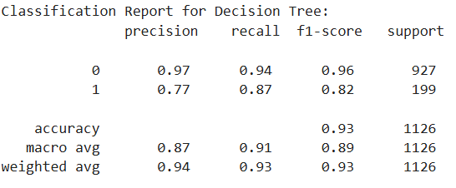
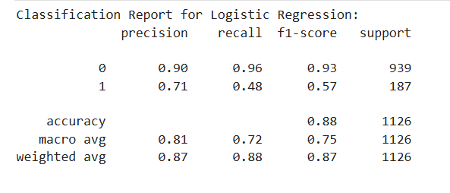
Predictive Models Comparison
Decision Tree Model:
Strengths: Easy to interpret, good for non-linear relationships.
Accuracy: 0.9316
Precision: 0.7723
Recall: 0.8693
Logistic Regression Model:
Strengths: Good for binary classification, interpretable coefficients.
Accuracy: 0.8809
Precision: 0.712
Recall: 0.4759
Best Model:
Decision Tree based on higher accuracy performance metrics of 0.9316.

Slide 11
Business Insights & Recommendations
Use advanced analytics to segment customers based on their buying behaviors and churn risk. This will allow for more targeted marketing and retention strategies.
Personalized loyalty and retention campaigns for shorter tenure customers and Mobile phone buyers to encourage repeat business and product upgrades
Satisfaction-Driven campaigns for customers with lower satisfaction scores. Also implement a proactive customer support.
Targeted Marketing for tier 1 and tier 3 cities by optimizing operational, logistics and delivery times and by introducing Localized offers in high-churn cities.
Complaint handling and proactive retention for customers with complaints by offering personalized solutions and compensations.
Engagement through exclusive content and offers by establishing educative and engaging updates as well as referral programs.
Continuously track churn-related data and refine strategies over time. Regular monitoring and adjusting strategies based on new insights.

Slide 12

Conclusion and Greetings
Churn analysis helps businesses retain customers. The analysis of customer churn reveals several critical factors impacting retention, including order recency, product preferences, satisfaction scores, and complaints. By identifying trends and understanding the reasons behind churn, we have highlighted actionable insights and strategic recommendations that can significantly improve customer loyalty.
The business can reduce churn by focusing on enhancing the customer experience, optimizing operations, and implementing targeted retention strategies.
Next steps: Implement marketing strategies based on findings.

Slide 13
Final Greeting
Thank you!
Q & A

